Slide 1
AC Price Analysis using Flipkart Data
Data-Driven Insights on Air Conditioner Pricing Using Python

Slide 2
About us
We are a team of B.Tech graduates in Electronics and Communication Engineering (ECE)
and aspiring data analysts passionate about transforming raw data into meaningful insights.
This project — “AC Price Analysis using Web Scraping and Pandas” — was developed to
study market TRENDS of air conditioners on Flipkart.
Our goal is to analyze pricing patterns, brand comparisons, and seasonal trends using data - driven techniques in Python.
Connect with me on Linkedin Surya Namburi
https://www.linkedin.com/in/suryaprakashnamburi/
Connect with me on Linkedin Mani K
https://www.linkedin.com/in/mani-k-79b359345/

Slide 3
Introduction
The air conditioner (AC) market is rapidly growing with diverse brands, models, and pricing strategies.
Understanding pricing patterns helps identify market trends and consumer preferences.
This project, “AC Price Analysis using Web Scraping and Pandas,” focuses on analyzing AC data
scraped from Flipkart to uncover insights about pricing, brand comparisons, and seasonal variations.
The analysis is performed using Python with tools like BeautifulSoup and Pandas for data extraction, cleaning, and visualization.

Slide 4
Business Problem
Consumers face difficulty in choosing the right AC due to varying prices, brands, and features.
Retailers and marketers need insights into pricing trends to remain competitive in the market.
The AC market is highly dynamic, with seasonal fluctuations affecting prices and consumer
demand.

Slide 5
Objective
To scrape real-time AC data from Flipkart using Python-based web scraping tools.
To analyze pricing trends across different brands, capacities, and features
(e.g., star rating, inverter type).
To visualize data insights through graphs and charts using Pandas and Matplotlib/Seaborn.
To derive data-driven insights that help understand market behavior and consumer choices.

Slide 6
Tools Used
1. Programming & Data Analysis:
  Python – Main programming language for scraping and analysis
  Pandas – Data manipulation and analysis
  NumPy – Numerical computations
2. Web Scraping:
  BeautifulSoup – Parsing HTML and extracting data
  Requests – Sending HTTP requests to web pages
  re (Regex) – Pattern matching for extracting features
3. Data Visualization:
  Matplotlib – Plotting graphs and charts
  Seaborn – Enhanced statistical visualizations

Slide 7
Data Collection (Web Scraping)
Source: Flipkart website – AC listings including price, brand, model, capacity, star rating, and inverter type.
Tools & Libraries:
  Python
  BeautifulSoup – for parsing HTML pages
  Requests – for sending HTTP requests
  Pandas – for storing and managing the dataset
Process:
  Send HTTP requests to Flipkart AC pages.
  Parse HTML to extract product details.
  Store extracted data in a structured CSV/Excel dataset.
Challenges:
  Dynamic website content & pagination
  Handling missing or inconsistent data
  Avoiding IP blocks during scraping

Slide 8
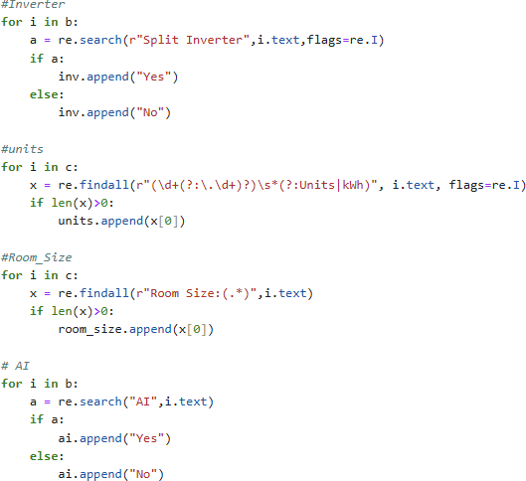
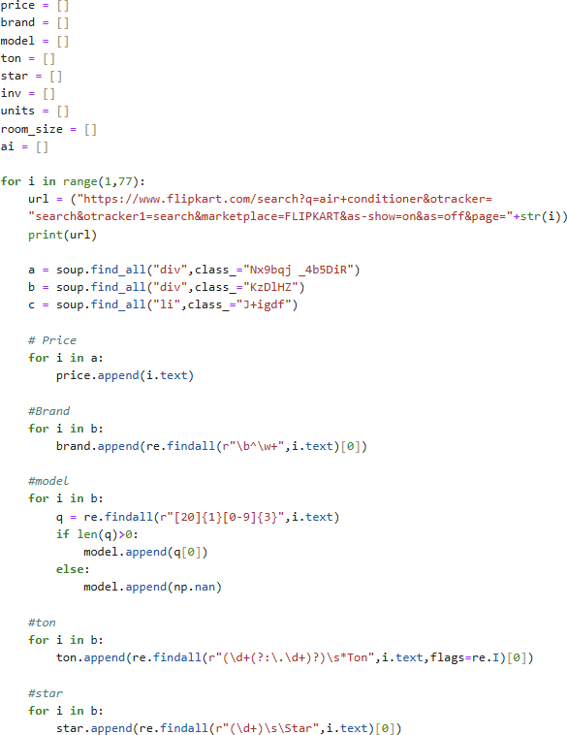
Web-Scrapping Code :

Slide 9
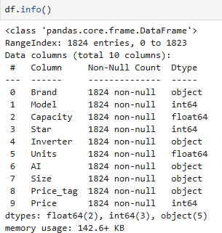
Dataset Overview
Number of Records: ~[1824 * 10]
Key Features / Columns:
  Brand – Manufacturer of the AC
  Model – AC model name/number
  Capacity – Cooling capacity in tons
  Star Rating – Energy efficiency (1★–5★)
  Inverter – Yes/No
  Units – Power Usage per annually
  Price – Listed price in INR

Slide 10
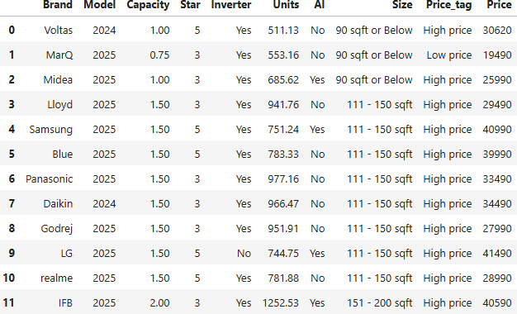
Sample Dataset

Slide 11
Data Cleaning & Preprocessing
Handling Missing Values:
  Replaced missing model names or features with NaN or default values.
  Removed rows with critical missing data (e.g., price).
Data Type Conversion:
  Converted Price and Capacity columns to numeric types for analysis.
  Converted Star Rating to integer.
Removing Duplicates:
  Checked for and removed duplicate entries to ensure data quality.

Slide 12
Feature Standardization:
  Standardized brand names (e.g., “LG” vs “Lg”).
  Standardized room sizes and inverter values to consistent formats.
Final Dataset:
  Clean, structured dataset ready for analysis and visualization.
  Columns: Brand, Model, Price, Capacity, Star_Rating, Inverter, Units, Room_Size, AI

Slide 13
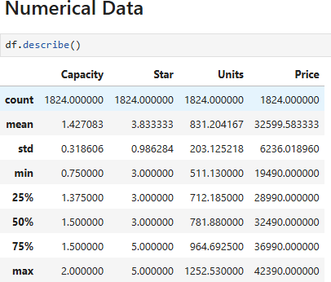
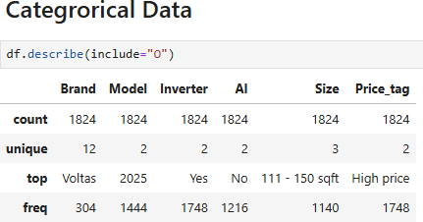
Exploratory Data Analysis (EDA)
Statistical Summary:
  Calculated mean, median, and mode of AC prices.
  Provides an overview of the central tendency and spread of the data.

Slide 14
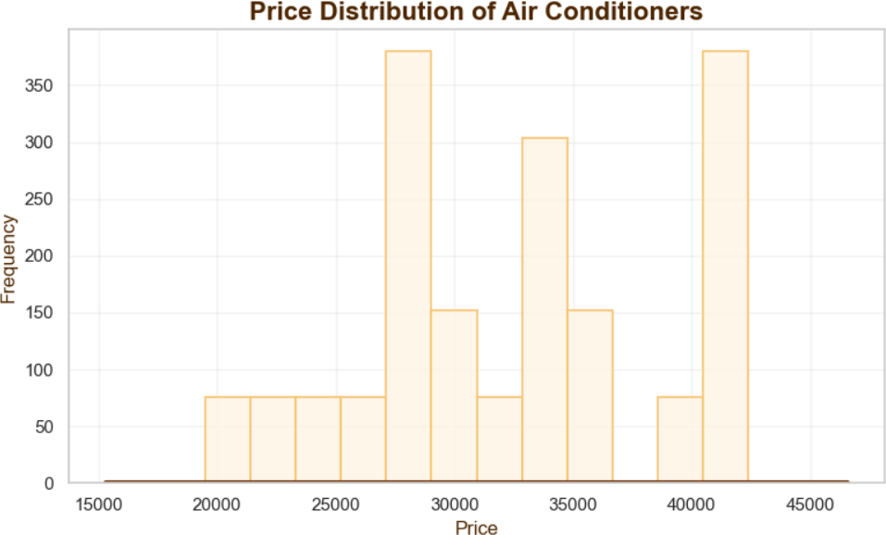
Price Distribution:
  Visualized AC prices using bar plot.
  Identifying price ranges.

Slide 15
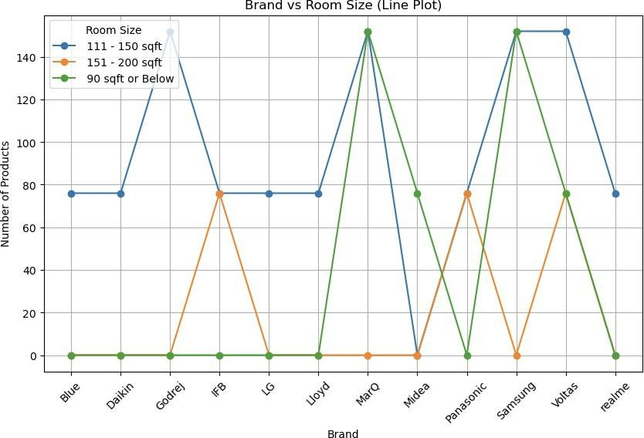
Brand Distribution across Area:
  Visualized AC Brand using Line plot.
  Identifying various Room Sizes.

Slide 16
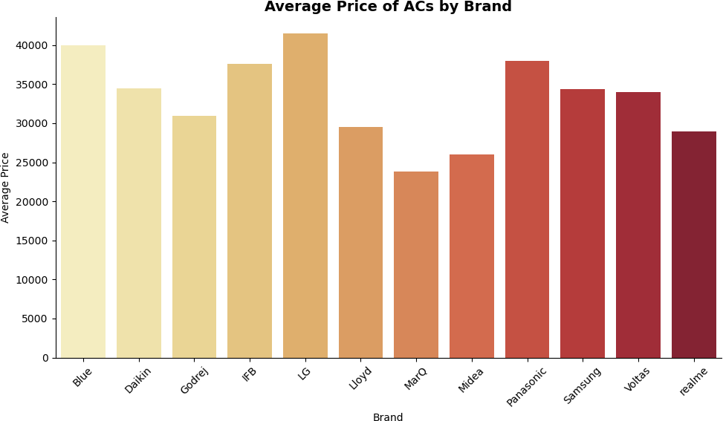
Brand-wise Price Comparison:
  Visualized Average AC prices using bar plot across Brands.

Slide 17
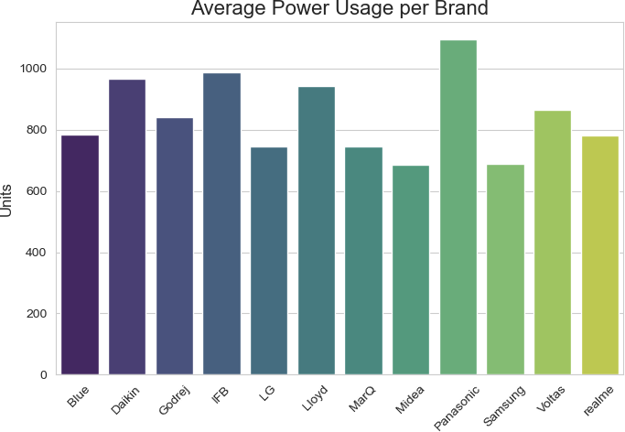
Brand-wise Power Distribution:
  Visualized Average power usage using bar plot across Brands.

Slide 18
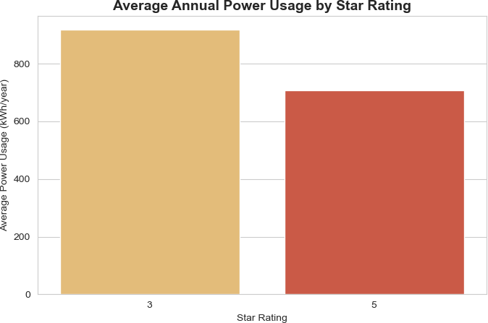
Power Distribution based on Star :
  Visualized Average power Distribution using bar plot across Star rating.

Slide 19
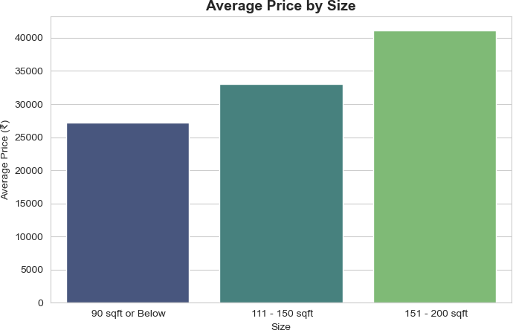
Price comparison based on Area :
  Visualized Average Price Comaprison using bar plot across Different areas.

Slide 20
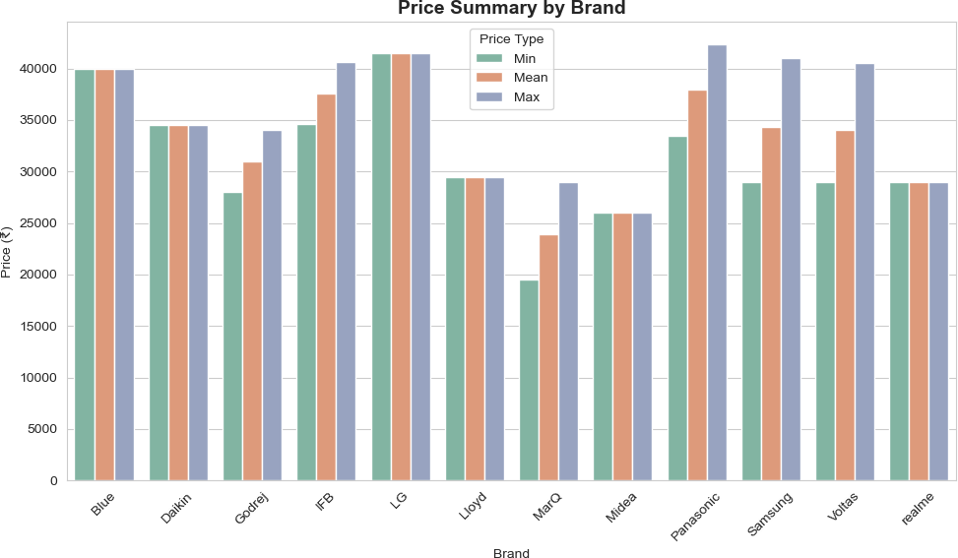
Price comparison based on Brands :
  Visualized Average Price Comaprison using bar plot across Different Brands.

Slide 21
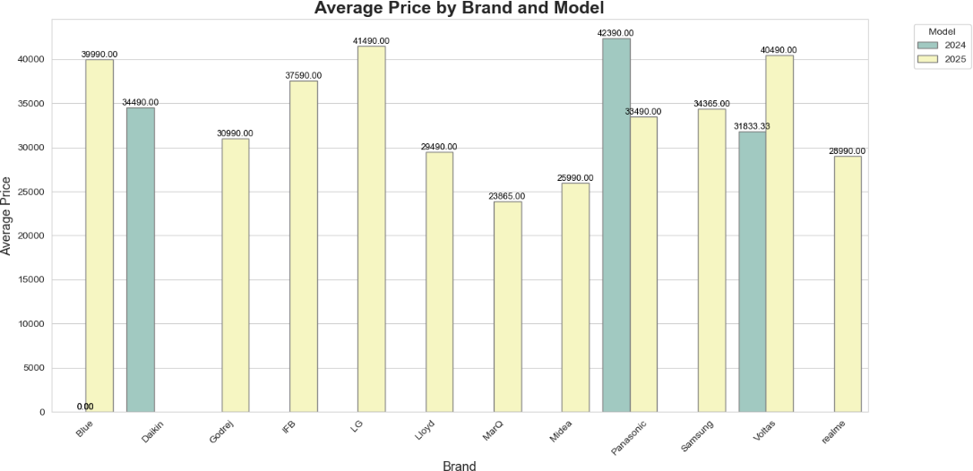
Price comparison based on Model :
  Visualized Average Price Comaprison using bar plot across Different Models.

Slide 22
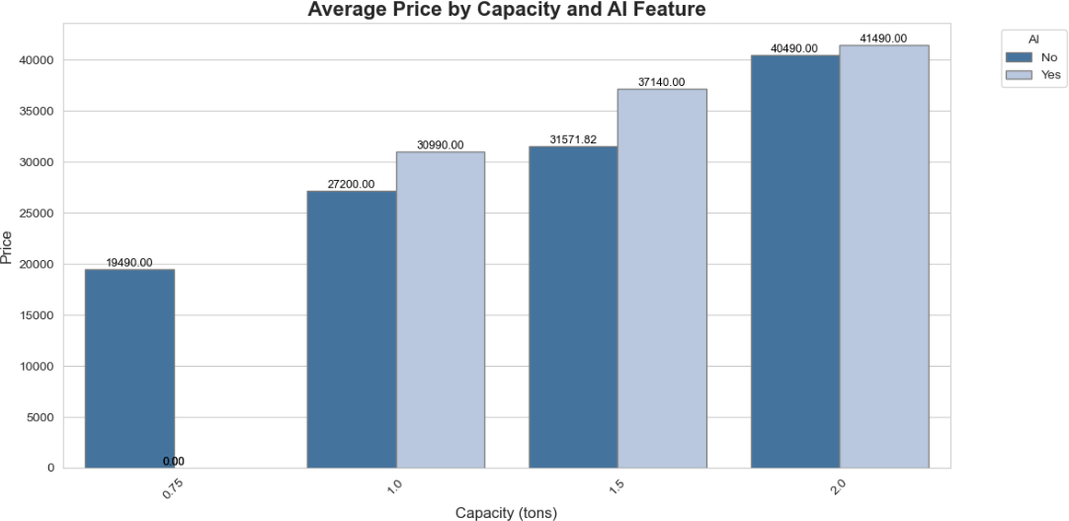
Price comparison based on AI :
  Visualized Average Price Comaprison using bar plot across AI.

Slide 23
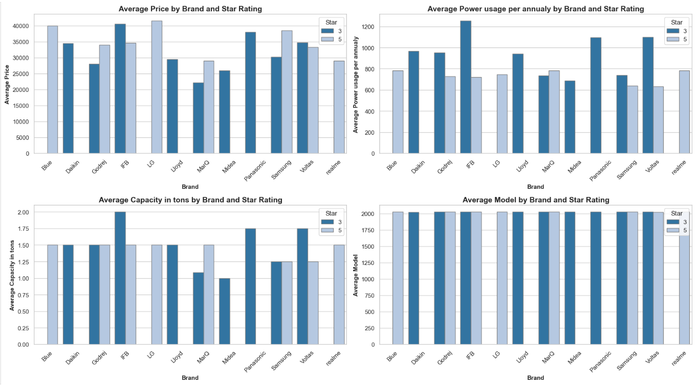

Slide 24
General Data Patterns
Metric | Observation
Average Price | ₹27,000 – ₹32,000
Price Range | ₹15,000 – ₹60,000
Most Common Capacity | 1.0 Ton (around 50% of all ACs)
Most Common Star Rating | 3-Star
Inverter AC Share | ~70% of products
AI Feature Share | ~30% of products
Interpretation:
Mid-range 1.0-ton, 3-star inverter ACs dominate the market, reflecting consumer preference for energy efficiency and moderate cooling capacity.

Slide 25
Brand Analysis
Brand | Median Price (₹) | Segment
LG | ~36,000 | Premium
Samsung | ~34,000 | Premium
Voltas | ~29,000 | Mid-range
MarQ | ~21,000 | Budget
Midea | ~26,000 | Budget-Mid
Insights:
Voltas and MarQ dominate the budget segment (<₹25k).
LG and Samsung target the premium inverter AC market (>₹32k).
Midea offers competitive pricing with AI and inverter features at mid-level prices.

Slide 26
Capacity vs. Price
Capacity (Ton) | Avg Price (₹) | Trend
0.75 | ~19,000 | Budget compact models
1.0 | ~27,000 | Standard segment
1.5 | ~32,000 | Premium segment
2.0 | ~38,000 | High-end models
Observation:
Price increases proportionally with capacity, showing a clear linear trend (correlation ≈ +0.7).

Slide 27
Key Questions:
Which brands offer the best value for money?
How do features like capacity, star rating, and inverter technology impact
price?
What are the seasonal trends in AC pricing?

Slide 28

THANK YOU

